Slide 1
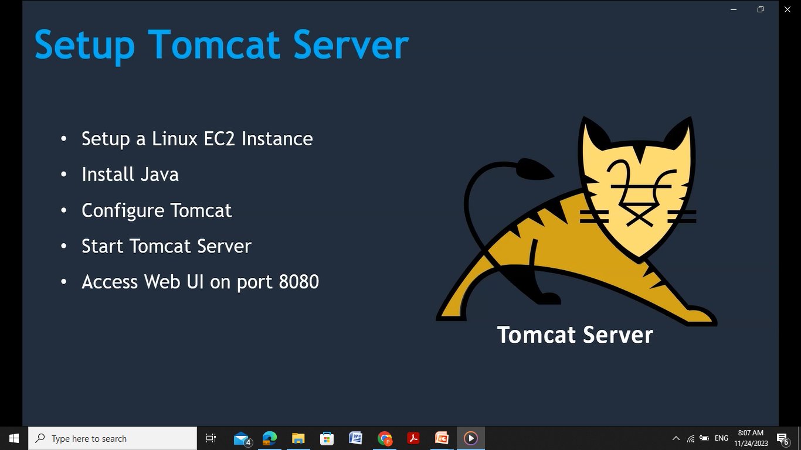

Slide 2
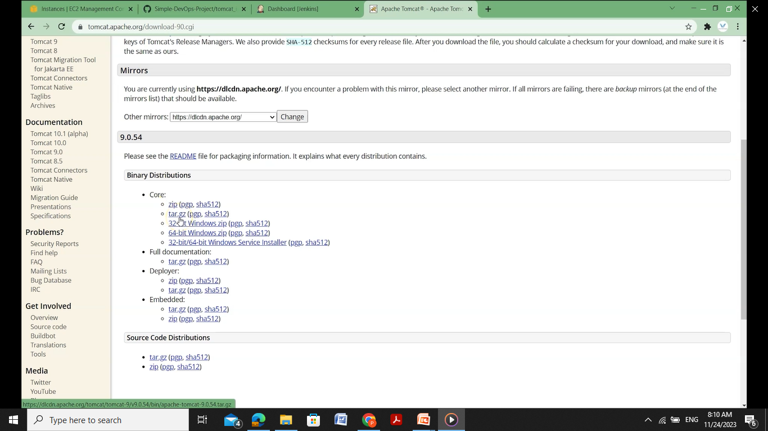
Goto-> tomcat server->binary distributions->tar.gz file

Slide 3
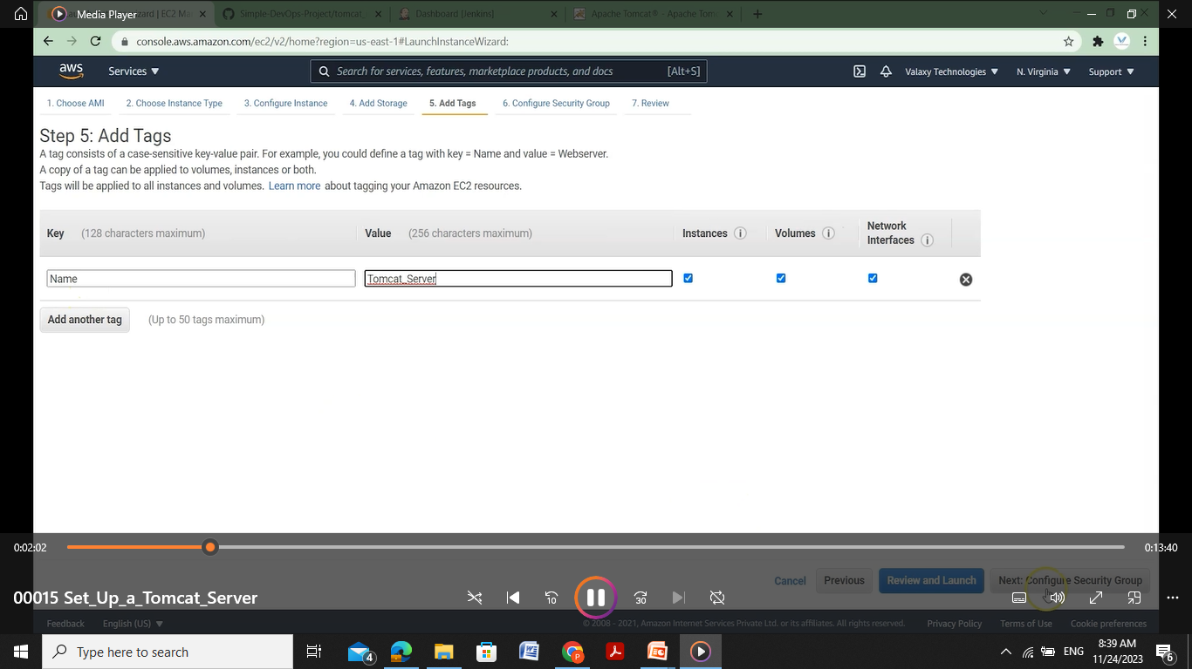
Launch new ec2 instance with modifications to add tags and security group

Slide 4
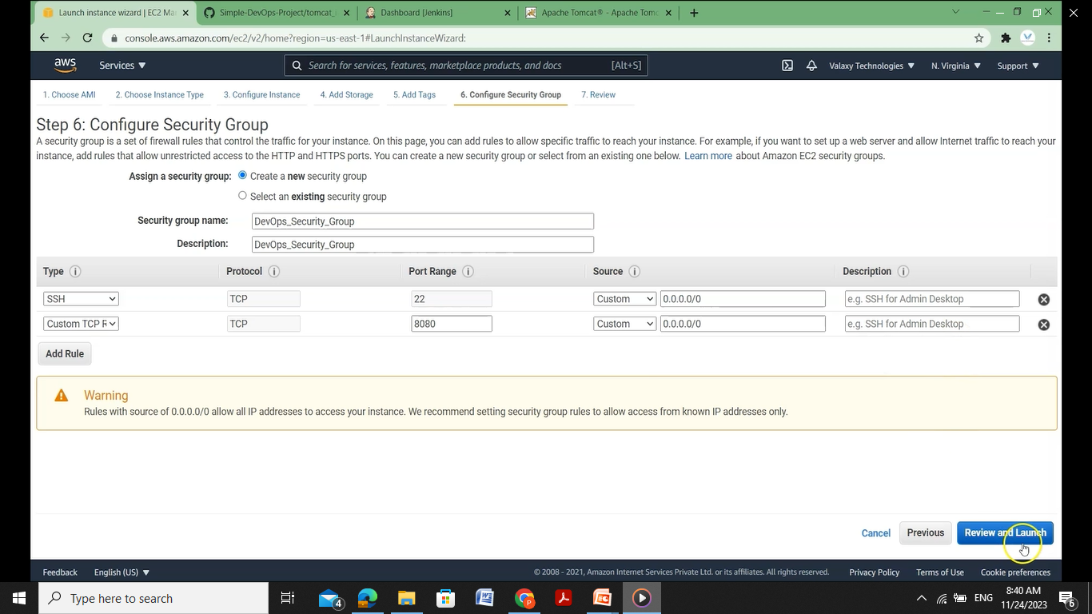

Slide 5
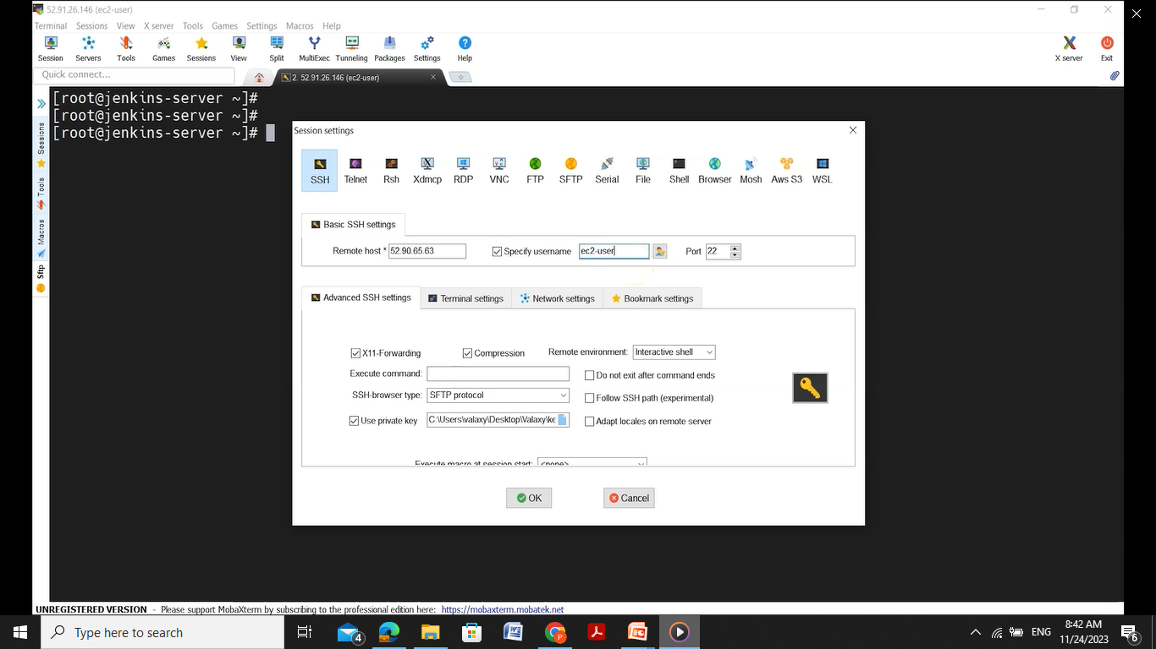
Copy the public IP from the instance and start ssh in mobaxterm

Slide 6
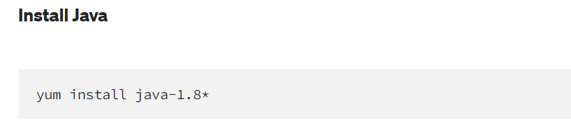
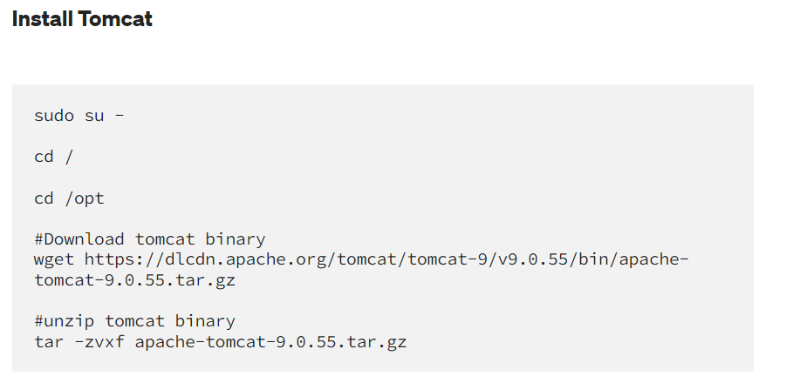
Now change to root directory and install java

Slide 7
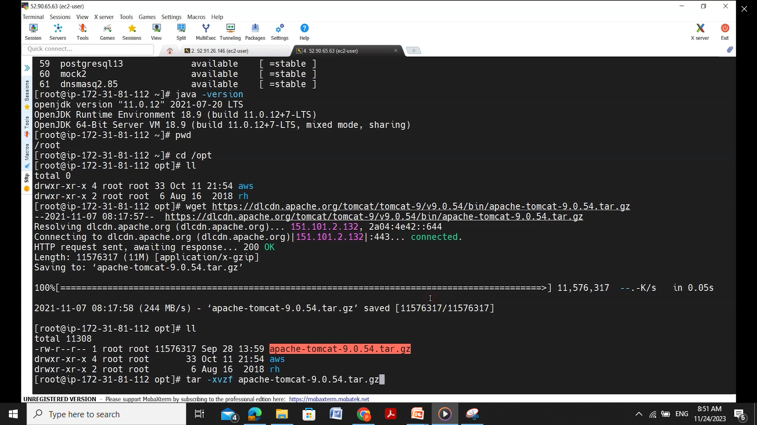

Slide 8
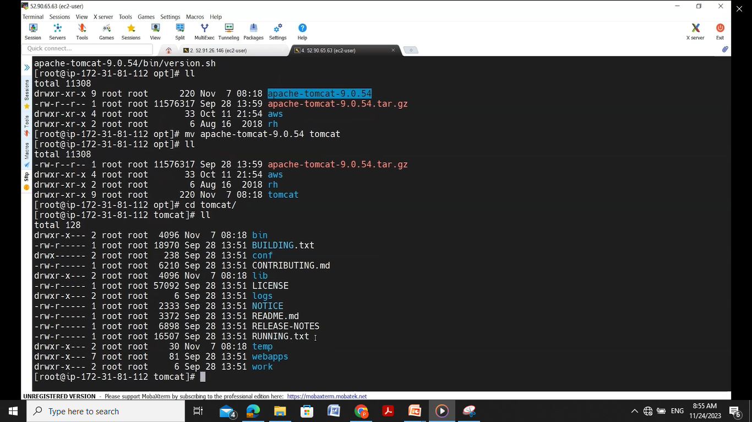
Move the tomcat -9.0.54 to just tomcat and move to bin directory

Slide 9
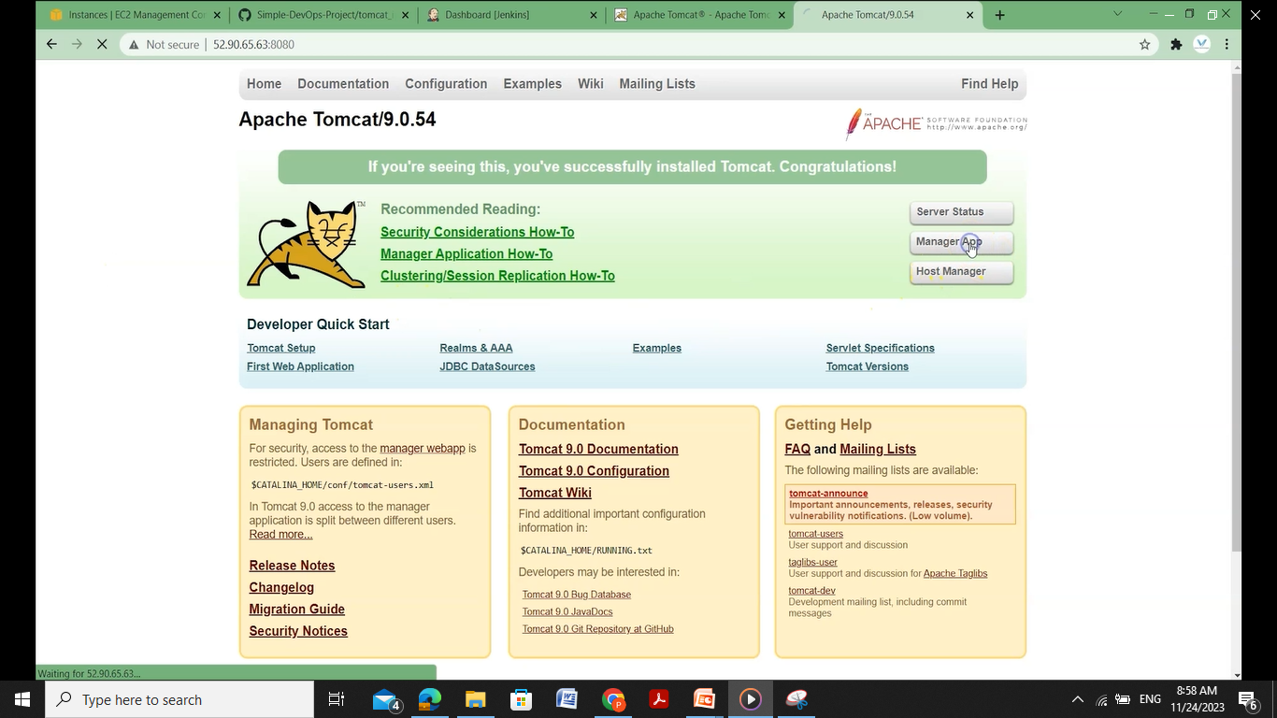
Check for tomcat installation by using the public IP and the local port address 8080

Slide 10
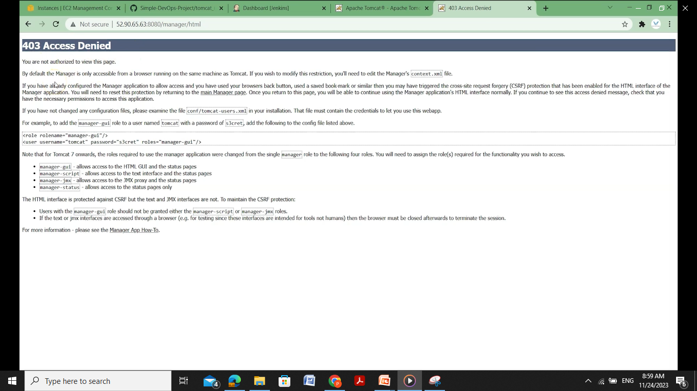
Now got to manager app present on the right top corner which should result in error

Slide 11
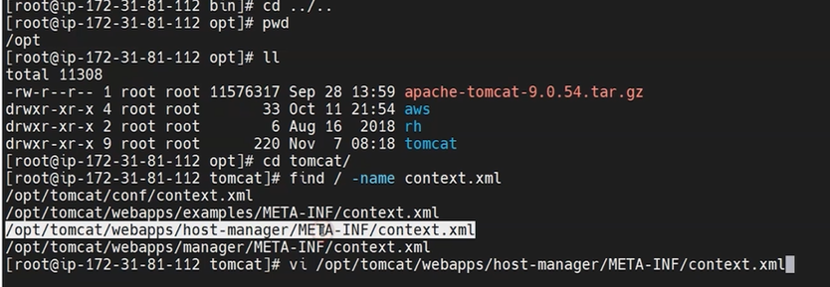
So we need to edit the context.xml file in order to rectify the error. Do the following steps by moving to tomcat

Slide 12
Comment out the value class name with <!- - and - - > as shown below the save and quit using wq

Slide 13
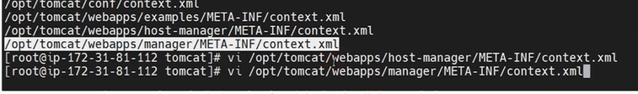
Repeat the same in another manager app

Slide 15
Comment out the value class name with <!- - and - - > as shown below the save and quit using wq

Slide 16
after the changes restart the tom cat server
move to bin ‘cd bin’ and then ./shutdown.sh
Then again start tomcat by the command ./startup.sh
Then again try to run the tomcat server by giving the url with public IP and local host address 8080
It should then ask for the credentials

Slide 17
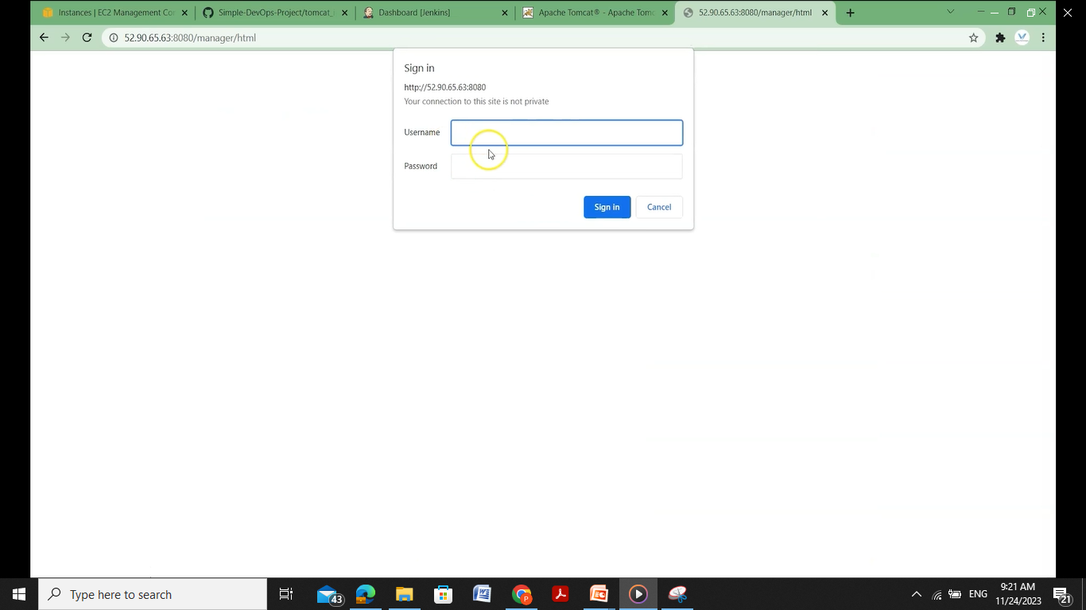

Slide 18
So for credentials we have to gofor ‘conf’ directory in tomcat
cd conf
Now we need to edit the tomcat users.xml file using the command vi tomcat-users.xml

Slide 19
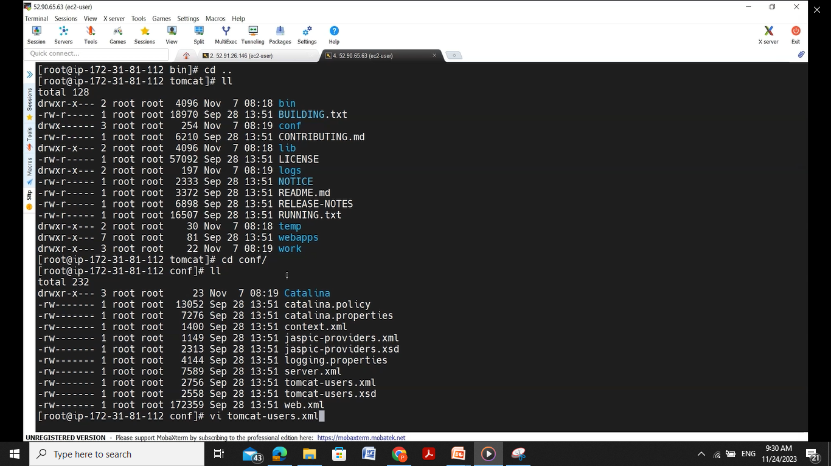

Slide 20
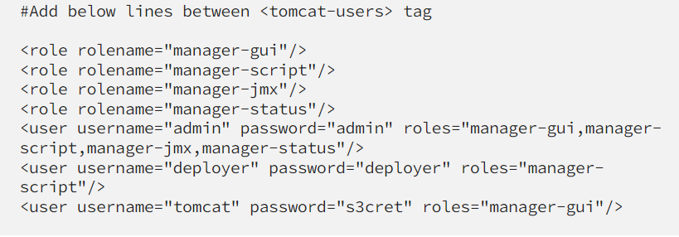
After the filed opened then goto end of the file by pressing ‘shiftg’

Slide 21
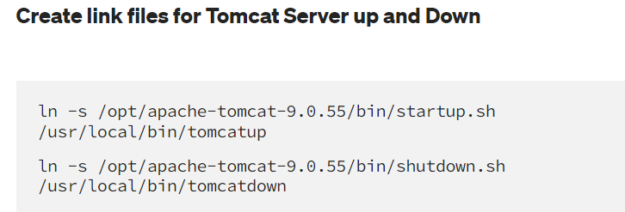
After adding the lines to the file save and quit then again restart the tom cat server

Slide 22
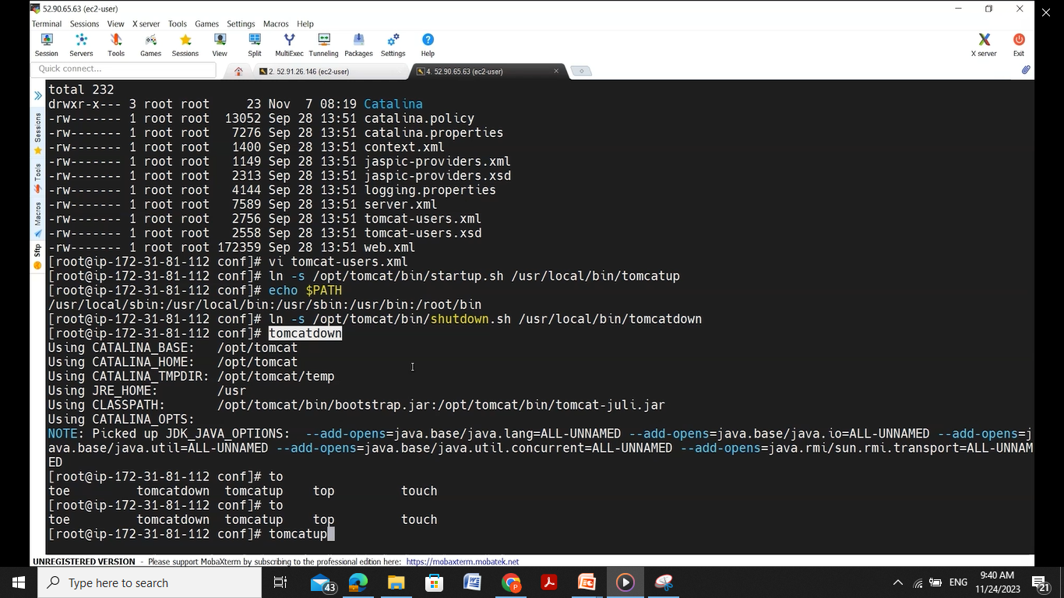
Then use tomcatdown to shutdown and next tomcatup to restart

Slide 23
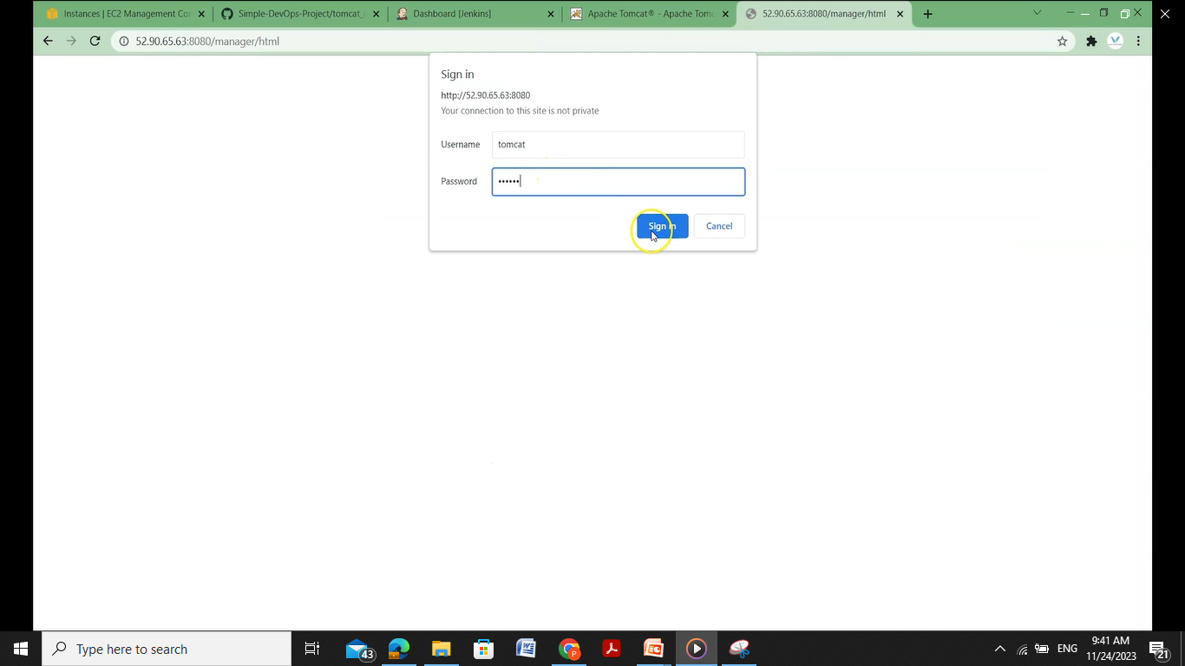
Now again the run tomcat using the ip and local port 8080 in url and see it asks for user id and password give the credentials as tomcat and s3cret

Slide 24
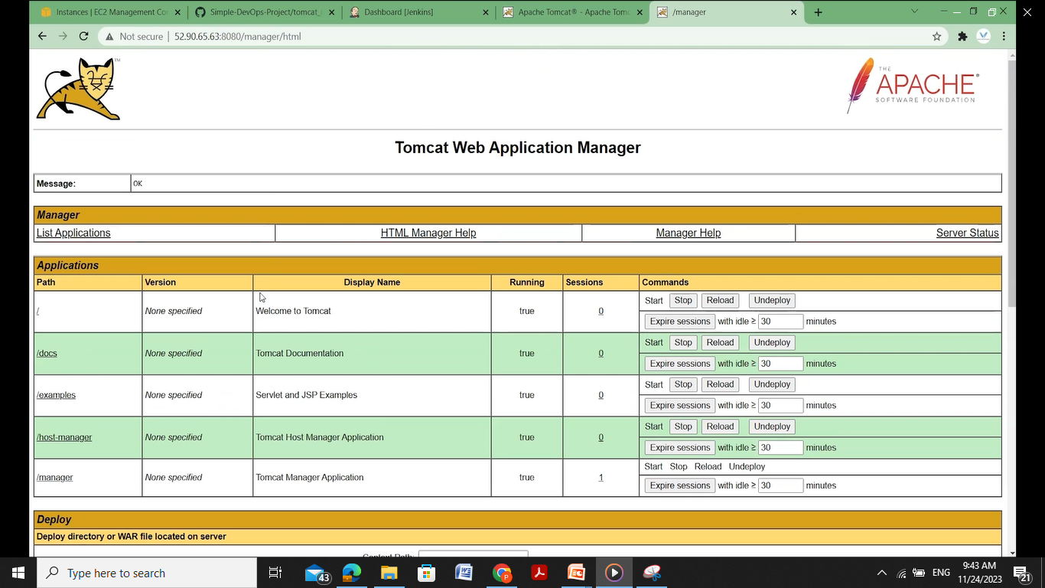
We can see the tomcat runs successfully

